Slide 1
Representing lexical resources
Laurent Romary, Inria

Slide 2
Overview
Lexical models – onomasiological and semasiological forms
Overview of the corresponding ISO standards
A general introduction to the TEI dictionary chapter
We will see the TEI guidelines in more general terms tomorrow
Hands-on discovery of the TEI dictionary model in oXygen

Slide 3
Lexical resources – a variety of objects
Lexical data as part of a wider landscape of language resources
First level of abstraction in linguistic analysis
Field linguistics, psycholinguistics, computational linguistics
Input to language technology processes
Wider interest from language learners and general public
A huge amount of legacy data
Proprietary formats
E.g. dictionary publishers
Proprietary tools
E.g. Shoebox
From highly narrative to deeply structured content
… open an MS Word document and start typing in your dictionary entry (sorry, just kidding)
Are there coherent principles in the representation of lexical data?
Can we treat electronic dictionaries and lexical databases in a uniform manner?

Slide 4
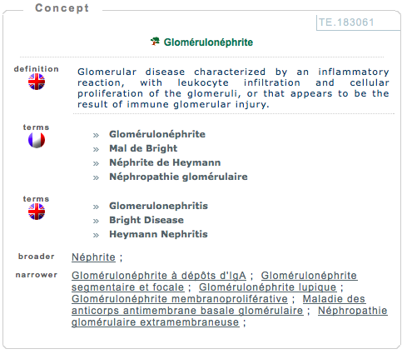
Various types of applications
Linguistic
Precise description of linguistic information
Natural language processing
Optical Character Recognition, Spell checkers, Information extraction
“Traditional” dictionary projects
Publishing industry, large scale dictionary projects (e.g. DWDS — http://www.dwds.de/)
Translation domain, technical writing
Terminological databases
Source: http://www.termsciences.fr

Slide 5
Why standardizing all this?
Defining methods or models to facilitate:
The exchange of lexical data
Pooling heterogeneous lexical data
Interoperability between software components
Search engines, layout, extraction of linguistic properties
Comparability of results
E.g. Linguistic coverage of lexical databases

Slide 6
Can scholars bear standards?
Standards are essentially “bad” for scientists
Freezing knowledge
Lost of time (which could be dedicated to “real” work)
Forcing diverging views to agree
…especially if the work is done by others
[also known as NIH syndrome: “not invented here”]
Forcing one to make data readable by others
…

Slide 7
How to answer reluctance?
Main issues
Managing the trade-off between interoperability and variability of linguistic representation
Documenting and maintaining document formats
A possible answer
Standards as specification platforms (metamodels, customisation processes)
Major factors
Expressing constraints on models, adaptation to use cases
Identifying generic structures, preventing representation silos
Each and everyone defining his/her own format…

Slide 8
What should be represented: form/layout or structure?
Considering the precise typographic information in the source dictionary
“Editorial” view on encoding
Should we go towards an HTML like transcription?
Simplifies direct legibility
Identifying the underlying logical structure
“Lexical” perspective
Needed for for any semantically oriented task (“give me all entries with senses related to the nautical domain”)
Defining a lexical database is always a compromise between the two
Depends on the available data and user scenarios

Slide 9
Standardization initiatives for lexical/terminological resources
TEI
Initiated in 1987, driving force behind XML creation
P5 edition of the guidelines
Cf. specification platform (ODD)
Dictionary chapter
Former terminology chapter
ISO
ISO/TC 37: Language and terminology
ISO/TC 37/SC 3: Management of terminology resources
ISO 16642 (Terminology), ISO 12620:1999 (Data categories), ISO 30046 (TBX)
ISO/TC 37/SC 4: Language resource management
ISO 24613 (LMF)
W3C
SKOS(, Ontolex)

Slide 10
Standards, standards, everywhere!
ISO TC 37 Language and terminology
TEI – Text Encoding Initiative
Stand-off annotation
MAF
Feature structures
ODD
SynAF
Transcription of speech
…
ISO-TimeML
TMF
TBX
Terminology chapter
MLIF
LMF
Dictionary chapter

Slide 11
Lexical structures at a glance
Observing the data:
Various forms of lexical structures
Basic distinctions:
Onoma- and semasiological structures
Onomasiological forms:
TMF and TBX
Semasiological forms:
LMF and TEI
Common concepts:
Data categories

Slide 12
Lexicography or terminology
Lexicography
Generic view on “words”
Attempt to provide a large coverage of a language
Semasiological view
Word > meaning(s)
Terminology
Term: form associated to a specific concept within a given domain
Onomasiological view
Concept > various possible linguistic forms
Again: depends on available data and user scenarios

Slide 13
Comparing approaches
Semasiological approach
Onomasiological approach
Large coverage
All parts of speech
Build-in polysemy
Multiple senses for the same entry
Referential synonymy
Domain oriented
Essentially nouns
Extension to verbs, adjectives
No polysemy (needs to be reconstructed)
Build-in synonymy
Multiple terms for the same concept

Slide 14
Standards for onomasiological data (concept to term)

Slide 15
Standards for the digital representation of terminologies
ISO 6156:1987 (Mater) — format for representing terminological information on magnetic tapes; followed by an adaptation for microcomputers (MicroMater; see Melby, 1991);
Chapter in the TEI guidelines; SGML-based representation; remained there until the P4 edition
ISO 12200 (Martif), published in 1999; improves the TEI proposal
Strongly inspired from the TEI (e.g. the header-text organisation; entries embedded within a <text> and <body> hierarchy)
Reaching out the translation and localisation industry
ISO 12620:1999, set of reference descriptors (or data categories)
ISO 16642:2003 (TMF) — Terminological Markup Framework
TBX (TermBase eXchange) published in 2007 by LISA (Localisation Industry Standards Association) as a follower to Martif
TBX: ISO standard 30042 in 2008 (revised 2019)

Slide 16
Modeling terminological entries with ISO 16642 and ISO 12620:1999
ISO 16642:2003 Computer applications in terminology -- Terminological markup framework
Provides a meta-model for the description of terminological databases
ISO 12620:1999 — Computer applications in terminology -- Data categories
Provides a reference set of descriptors for building-up terminological data models

Slide 17
Building up a terminological model (TMF)
Terminological entry
Language section
Term section
Term section
Language section
Term section

Slide 18
Building up a terminological model
Terminological entry
Language section
Term section
Term section
Language section
Term section
subjectField
definition+source
note
term
source

Slide 19
TBX serialisation (ISO 30042)
<termEntry xmlns="http://www.tbx.org">
<descrip type="subjectField" xml:lang="fr">Industrie mécanique</descrip>
<langSet xml:lang="de">
<descripGrp>
<descrip type="definition">endloser Riemen mit trapezförmigem Querschnitt, der auf zwei Riemenscheiben mit Eindrehungen läuft</descrip>
<admin type="source">De Coster, Wörterbuch, Kraftfahrzeugtechnik, SAUR, München, 1982</admin>
</descripGrp>
<note>wird zum Antrieb der Lichtmaschine, des Ventilators und der Wasserpumpe benutzt</note>
<tig>
<term>Keilriemen</tei:term>
<admin type="source">De Coster, …</admin>
</tig>
</langSet>
<langSet xml:lang="fr”>
<tig>
<term>courroie trapézoïdale</term>
…
</tig>
</langSet>
</termEntry>

Slide 20
Quick wrap-up
Implementation in numerous industrial project
Translation workbenches (e.g. Trados), European commission, etc.
Definition of specific “flavors”
Fixed sets of data categories
TBX-basic, TBX-min
Integration to the TEI guidelines
Terminological entries in wider text-based applications (e.g. technical writing)

Slide 21
Standards for semasiological data (word to sense)

Slide 22
ISO/WD 24613-1 (revised) Language resource management — Lexical markup framework (LMF) — Part 1: Core model

Slide 23
ISO/TC 37/SC 4/WG 4 The LMF series
Initial publication: ISO 24613:2008 Language resource management - Lexical markup framework (LMF)
ISO 24613-1:2019 Language resource management — Lexical markup framework (LMF) — Part 1: Core model
ISO/WD 24613-1 Language resource management — Lexical markup framework (LMF) — Part 1: Core model
ISO 24613-2:2020 Language resource management — Lexical markup framework (LMF) — Part 2: Machine-readable dictionary (MRD) model
ISO 24613-3:2021 Language resource management — Lexical markup framework (LMF) — Part 3: Etymological extension
ISO 24613-4:2021 Language resource management — Lexical markup framework (LMF) — Part 4: TEI serialization
ISO 24613-5:2022 Language resource management — Lexical markup framework (LMF) — Part 5: Lexical base exchange (LBX) serialization
ISO/WD 24613-6 Language resource management — Lexical markup framework (LMF) — Part 6: Syntax and Semantics

Slide 24
TEI and “dictionaries”
The TEI Dictionary chapter (known before as the Print Dictionary)
Initially designed by N. Ide and J. Veronis (1995)
Accounts for both presentational and editorial (“content”) issues
Cf. <entry>, <entryFree>, … and <dictScrap>
Based on a hierarchical abstract model (crystals)
<form>: for characterizing the orthographic or phonetic form of the word
<orth>, <pron>, etc.
<gramGrp>: grammatical features
May characterize an entry, a specific form or a specific sense
<pos>, <gen>, generic <gram> feature
<sense>: iterative and recursive
May contains definitions, examples, etymological information, translations, etc.
Main characteristic (drawback?): +very+ flexible
Ide, N., & Véronis, J. (1995). Encoding dictionaries. In Text Encoding Initiative (pp. 167-179). Springer, Dordrecht.

Slide 25
Prototypical entry in TEI
<entry>
<form>
<orth>table</orth>
</form>
<gramGrp>
<pos>n.</pos>
<gen>f.</gen>
</gramGrp>
<sense>
<def>Pièce de mobilier…</def>
<cit type=”example”>
<quote>Une table de cuisine</quote>
</cit>
</sense>
</entry>
Notes:
Issues: definition of grammatical information (classes), definition of gen, constraining the values => customization, what about semantics,

Slide 26
Example – simple word to sense representation
<entry> <form>一乘顯性教</form> <sense>One of the five divisions made by 圭峰 Guifeng of the Huayan 華嚴 or Avataṃsaka School; v. 五教.</sense> </entry>
<entry> <form>眾生不可思議</form> <sense> <usg type="dom">術語</usg> <def>四事不可思議之一。見不可思議條。</def> <ref>不可思議</ref> </sense> </entry>
Source: http://buddhistinformatics.ddbc.edu.tw/glossaries/;
thanks to Marcus Bingenheimer

Slide 27
Example – full-form lexicon
<entry> <form type="lemma"> <orth>chat</orth> </form> <gramGrp> <pos>noun</pos> <gen>masculine</gen> </gramGrp> <form type="inflected"> <orth>chat</orth> <gramGrp> <number>singular</number> </gramGrp> </form> <form type="inflected"> <orth>chats</orth> <gramGrp> <number>plural</number> </gramGrp> </form> </entry>

Slide 28
IRL: Petit Larousse illustré (1906)
<entry xml:id="pléthore" n="1906-001_unknown"> <form type="lemma"><orth>PLÉTHORE</orth></form> <gramGrp><pos expand="nom">n.</pos> <gen expand="féminin">f.</gen></gramGrp> <etym><pc>(</pc>du <lang expand="grec">gr.</lang> <mentioned>plêthorê</mentioned><pc>,</pc> <gloss>plénitude</gloss><pc>)</pc><pc>.</pc></etym> <sense><def>Surabondance de sang, d'humeurs</def><pc>.</pc></sense> <sense><usg type="style" rend="italic" expand="figuré">Fig.</usg> <def>Surabondance quelconque amenant un état fâcheux</def> <pc>:</pc> <cit type="example"> <quote>la pléthore des capitaux cause la diminution du taux de l'intérêt</quote> </cit><pc>.</pc></sense> </entry>
Work carried out within the Nénufar project - DGLFLF

Slide 29
Serializing LMF using the TEI

Slide 30
Why is the TEI a good idea for serialising LMF?
Basic structure already defined
Provision of additional tags
Surface annotation (e.g. names, dates, abbreviations, alternatives)
Cf <equiv> equivalences to reference data categories when needed
Integration of lexical data in a textual macro-structure
Creating an edited version of a lexica
Grammar books, teaching material, scientific papers
Interoperability with other lexical sources
Community of users: sharing a common culture of TEI tags rather than constantly worrying about mappings
Sharing tools: e.g. stylesheets, editors, etc. (cf. Roma)
Note: continuity between dictionary and lexical sources

Slide 31
From LMF to TEI – serialising one with the other
<teiCorpus type="lexicalResource">
<teiHeader>
<TEI type="lexicon">
<teiHeader>
<entry>
<gramGrp>
<form>
<sense>
<orth>
<def>
<form type="lemma">

Slide 32
Advantages of being in the TEI framework
Benefitting from the TEI environment
TEI Modelling Language: ODD
Customizing the guidelines within a project (e.g. restraining possible values)
Availability of a wealth of additional elements
E.g. annotating textual content, reflecting the specificities of the source etc.
Standardisation reactivity
Issuing GitHub tickets for resolving bugs or introducing new features
A community of experts
Support through the mailing list
Main characteristic (drawback?): +very+ flexible

Slide 33
Going ISO to provide a stable background
Advantages of going ISO
International approval of ISO members
And international expert participation by construction
Stable background that is easy to reference (and known by third parties, non linguistic geeks, our institutions etc.)
From a lexical point of view
Providing a generic model, independently of any specific implementation/serialisation
Stabilizing concepts, constraints and vocabulary
With LMF part 4: Introducing the TEI as one possible serialisation

Slide 34
Issues and prospects
Stabilizing good practices in TEI encoding
Identifying a catalogue of reference constructs for various lexicographic phenomena
Improving interoperability and delivery possibilities across dictionary projects
A single data soup
Creating specific delivery formats: Ontolex, ePub…

Slide 35
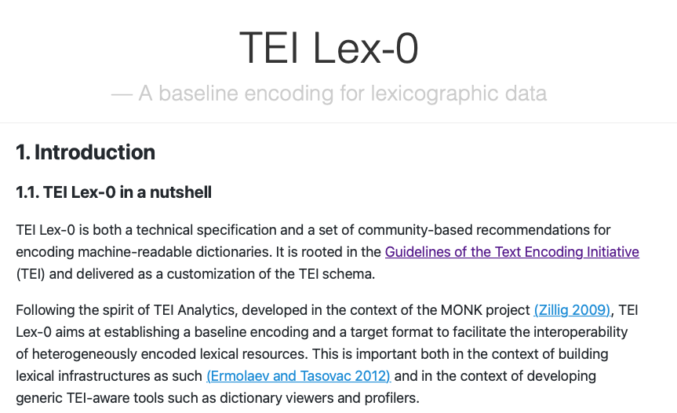
Tightening the TEI guidelines further

Slide 36
TEI lex 0: overview
Initiative set up in the context of the DARIAH working group on lexical resources
Sebastian Rahtz prize for TEI ingenuity
Objectives
Designing a target format for heterogeneous lexical data integration
Trade-off
Compliance with the TEI standard
Fine-tuning to the needs of a specific context/scenario
Back to what a standard is: a common reference for a transaction
Perfect to say: “I am compliant to standard X except for…”
The TEI guidelines provides the means to carry out such customizations

Slide 37
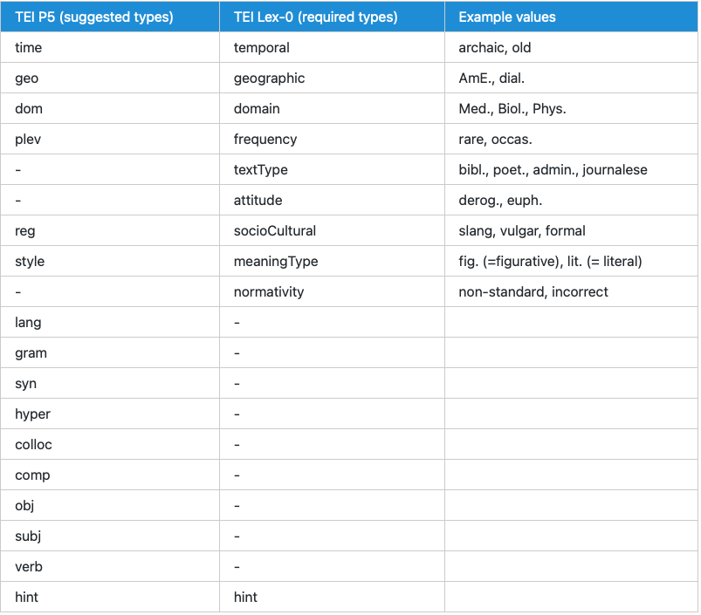
<usg type=“XXX”> in TEI Lex-0

Slide 38
Application – the ELEXIS project
European Lexicographic Infrastructure
2018-02-01 – 2022-01-31
“integrate, extend and harmonise national and regional efforts in the field of lexicography”
Focuses on “efficient access”
Cooperation with CLARIN and DARIAH for long-term sustainability
Lexical formats and standards in ELEXIS
Double sided approach TEI – Ontolex
TEI Lex 0 specification at the core of the data hub

Slide 39
The ELEXIS centralized hub
Dict 2
Dict…
Dict 1
Dict n
ODD
ODD
ODD
ODD
TEI Lex 0 “soup”
ODD
Ontolex delivery
User

Slide 40
Next steps
Further components
Etymology, examples with sources, usage etc.
Precise documentation in TEI Lex-0
Components of a lexical projects from the point of view of data modelling
Select a representative sample
Assess encodability wrt. TEI all – TEI Lex-0
Design your own TEI (Lex-0) subset
Edition control, project documentation
Using ODD…

